Slide 1

Module 0 – SMA-X Overview
Jan 2018
Notes:
[STANDARD SLIDE: L300 (animated)]
You can change out the photo with any image from Getty Images in DropBox.
If the main title is shorter, you can make the font larger.
You may have to move the title text around depending on the photo. Make sure the text is readable against the background photo.
You can change the background color for the rectangle in the bottom-right corner to look better against the background. Choose a Micro Focus color at 25% transparency.
=========================
Note to Narrator or Reader: [PRESS] indicates press the Page Down key to show the animation
=========================
Hello and Welcome to the [COURSE_NAME] Technical Overview Training, Level 300.
In this course you’ll gain a high-level understanding of the essentials of [PRODUCT_NAME].
[PRESS] If you want to download this presentation and save it on your own system, click the Tools & Help icon in the bottom-right corner of your window and select Download.
Or, if you want to access the PPT slides and speaker notes for future reference, go to the Attachments tab in your window click to download the presentation.

Slide 2
Course Objectives and Logistics

Slide 3
Course Objectives
Describe the differentiating features of the SMA Suite
Understand the differences between SMA-SM and SMA-X
Use the SMA-X Self-Service and Agent Interfaces for all modules
Demonstrate all of the SMA-X process modules

Slide 4
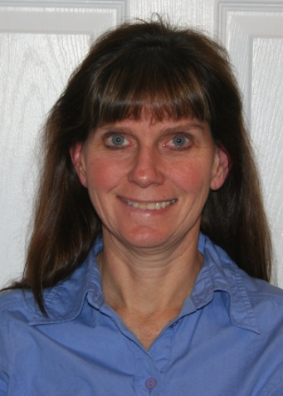

Your Instructors
Carol Hibbard
Alex Borovsky
Ocala, FL, USA
Previously Cincinnati, OH
36 yrs with HP/HPE/Micro Focus
2 years in Technical Enablement
16 years in pre-sales for ITSM solutions
5 years in Professional Services for ITOM solutions
Barcelona, Spain
Previously Kazakhstan
11 yrs with HP/HPE/Micro Focus
2 months in Technical Enablement
10 years in Pre-sales for ITOM solutions
1 year in Professional Services for ITOM solutions

Slide 5

Class Logistics
Student guides, exercises, demo cards and additional materials are provided in the handouts.
By the end of the training, you should be able to demonstrate SMA-X to a customer.
The class has been recorded for you to take when you can.
Please allow approximately three (3) days. It is a mixture of lecture and demonstration exercises each day.

Slide 6
Mandatory Pre-Requisites for this Class
Before attempting this class, you should have already completed:
SMA Suite Level 300 Technical Overview and Knowledge Check on SABA course 000000000004923
SMA Suite: Technical Awareness Webinar for newer releases after 2018.01 on SABA
Notes:
Service Anywhere: Interactive Training Created by ART
Partner link:
http://h20507.www2.hp.com/Saba/loginAsUser.jsp?deepLinkName=CourseDetail&deepLinkParams=courseId=00989938
Employee Link:
http://grow.hp.com/Saba/Web/Main/goto/CourseDetail?courseId=00989938
Service Anywhere: Sales Awareness Webinar March 2015
Partner link:
http://h20507.www2.hp.com/Saba/loginAsUser.jsp?deepLinkName=CourseDetail&deepLinkParams=courseId=00984086
Employee Link:
http://grow.hp.com/Saba/Web/Main/goto/CourseDetail?courseId=00984086
Service Anywhere: Technical Awareness Webinar March 2015
Partner link:
http://h20507.www2.hp.com/Saba/loginAsUser.jsp?deepLinkName=CourseDetail&deepLinkParams=courseId=00984083
Employee Link:
http://grow.hp.com/Saba/Web/Main/goto/CourseDetail?courseId=00984083

Slide 7
Course Modules
0. Overview and Architecture
Using SMA-X User Interfaces
Service Asset & Configuration Management
Using the Service Catalog
Knowledge Management
Service Request Management
Incident Management
Problem Management
Change and Release Management
Service Level Management
Reports and Dashboards
Survey Management
HR
Data Segmentation
Idea & Proposal Management
Project & Program Management
Application Portfolio Management

Slide 8
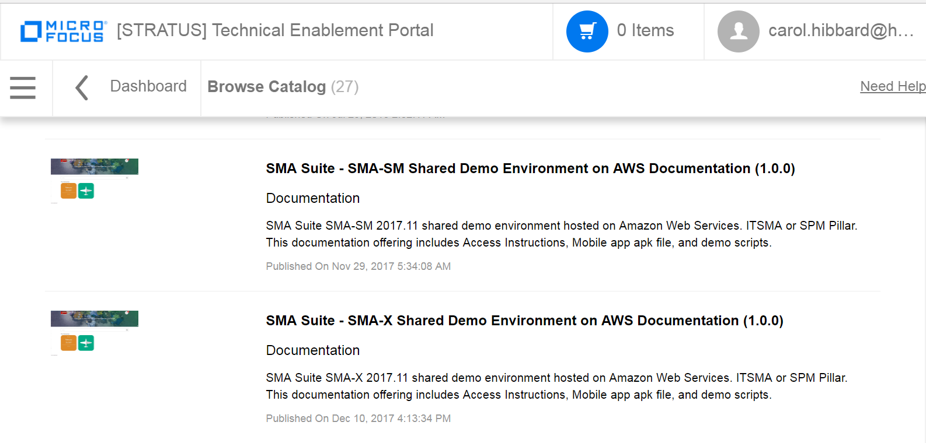
SMA-X Lab Environment
https://hpswdemoportal.com
Your training was based on the SMA-X 2017.11 version, and demo cards are provided for this release in your training handouts. You can, however go to Stratus to collect the latest SMA-X demo cards.
We will use the shared demo or shared playground SMA-X environments for the demo card exercises.
Some of these demo cards will be used as your exercises

Slide 9
SMA-X Demo Cards
2017.11 release
APM (Application Portfolio Mgmt)
Change Mgmt
Data Access - Segmentation themes and encryption
HR (Human Resources)
Idea and Proposal Mgmt
Incident and SLM Mgmt
Mobile
Release Mgmt
Reporting and Hot Topic Analytics
SACM and ITAM
Self Service
Service Request and Catalog
The “Project and Portfolio Mgmt” and the “Project and Portfolio Optimization” are available but not published on Stratus due to current issues when executing them.

Slide 10
Module 0 - Overview

Slide 11
Module 0 – Overview Objectives
After completing this module, you should be able to:
Describe the key differentiating features of SMA
Describe the Suite licensing and architecture
Understand the SMA-X multi-domain and multi-tenant deployment options
Understand the differences between SMA-SM and SMA-X

Slide 12
Key Features of Service Management Automation (SMA) Suite - Recap

Slide 13
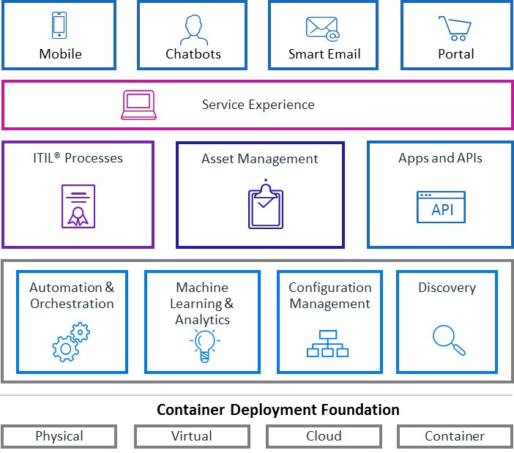
Service Management Automation Suite
Innovative architecture, built for agility and scale
Smart service desk
Easy to use self-service
ChatOps collaboration
Flexible deployment, codeless configuration
Automated service modeling and discovery
Notes:
Today’s IT service desks are costly and inconsistent due to manual processes and the inability to monitor IT assets across the network. Frustrated users bypass the service desk to develop their own solutions, increasing the risk of audit and non-compliance s we have seen earlier. How can Service Management Automation help with this situation?
Service Management Automation provides an analytics-driven, highly automated and orchestrated service management solution including ITIL process orchestration and asset management:
Google-like service portal with big data-powered knowledge delivery is easy to use and understand.
A smart service desk built upon unique analytics and machine learning and SLA monitoring provide delivery and trend visibility, and automates ticket management as well as other processes.
Codeless configuration radically simplifies the task of creating, configuring and maintaining IT process workflows, enabling fast ITIL process maturity adoption.
Collaboration via ChatOps allows to share knowledge across teams for fast issue resolution.
Enhanced audit reporting and asset optimization via Universal Discovery (UD), UCMDB, and Asset Manager increase accuracy.
Finally, flexible deployment …
Service Management Automation (SMA) has been setup to revolutionize the market. The new IT Operations Management (ITOM) platform delivers a new micro service architecture that leverages Docker Containers along with Kubernetes advanced orchestration capabilities. This combined with pre-built out-of-the-box integrations, automation capabilities, open APIs and a choice in deployment options makes SMA the best choice on the market.
Service Management Automation Suite is uniquely positioned to deliver a powerful set of Service Management capabilities without the typical cost and complexities associated with other SMA products on the market. Micro Focus delivers a suite of fully integrated Service Management capabilities to customers using agile methodologies. They allow to rapidly promote new capabilities to customers and significantly reduce the time to value realization period. This new delivery model leverages containers and micro services to further modularize the capabilities while dramatically lowering the cost and complexity of enabling Service Management capabilities for customers. Since Service Management Automation is just one of several suites that will be delivered using the agile delivery model, suite to suite integration is also a key design element.

Slide 14
Smart Service Desk
Powered by analytics and machine learning
End user
Simple and fast submission
Quick answers
Instant help
Superior self-sufficiency
Automatic knowledge delivery
Smart Ticket
IT Agent
Automatic ticket classification
Intelligent knowledge delivery
24 x 7 service desk availability
Automatic ticket routing
Turn data into actionable insights
Smart Search
End User Chat
Smart Email
Hot Topic Analytics
Notes:
Built on an OEM-licensed version of IDOL, Big Data analytics and machine learning drive automation further into service management processes by mining unstructured data and by extracting information from different types of data to enable a smart service desk:
Improving the processes of Help Desk management, including ticket management
Improving search experience across a variety of internal and external content to find answers quickly
Reducing the time and effort expended on interaction submittals by end users and IT professionals
Provide 24x7 help desk support via email and bot chat
Accelerating the process of problem management
For end users:
Simple and fast submission ->Improve user satisfaction
Find answers quickly -> Save effort and guess work
Self-sufficiency -> Always on: anytime – 24x7
Automatic knowledge delivery -> Increase user productivity
For IT Agents and Managers:
Automatic ticket classification -> Quick resolution times
Intelligent knowledge delivery -> Find answers quickly
Automatic ticket routing -> Fast and accurate assignment
Turn data into actionable insights -> Proactively spot hot topics Identify data trends

Slide 15
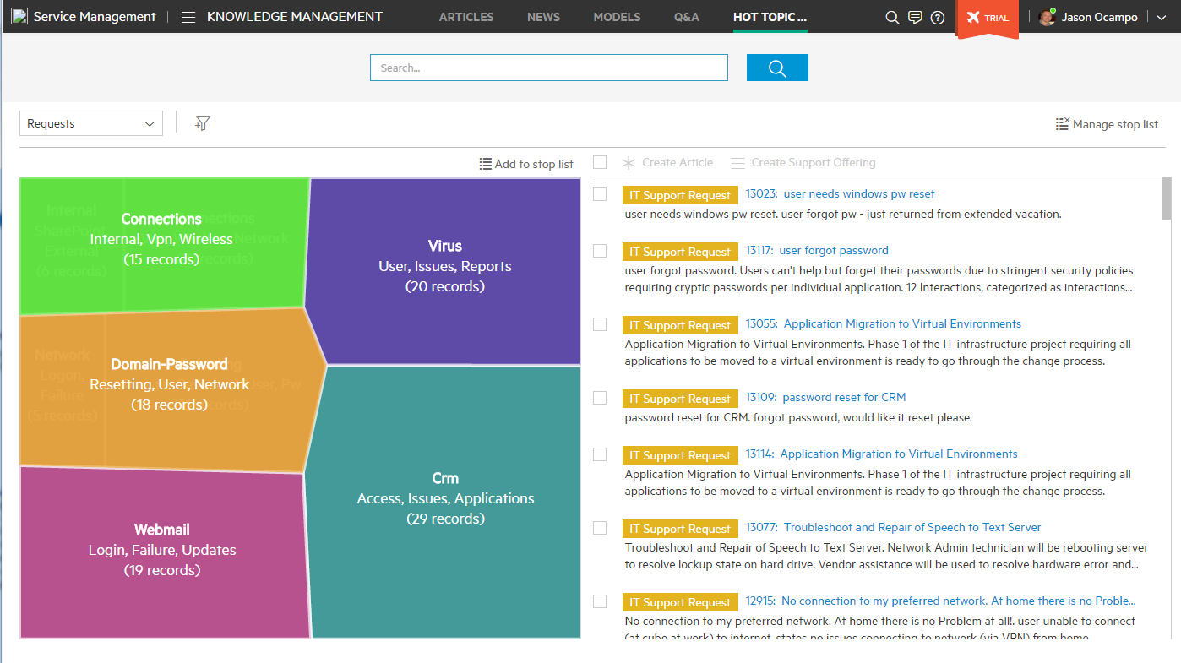
Hot Topic Analytics
Leveraging Big Data technology
Search for hot topics
Configure stop word lists
Shows analysis of important interest areas
Create
knowledge articles
catalog offerings
problem records
Displays hot topics and record counts
Notes:
Here is a sample screenshot of one of the capabilities discussed before.
It shows Hot Topic Analytics, which intelligently searches for patterns and clusters in structured and unstructured data, within and outside the service desk if desired. The sample screenshot shows Hot Topic Analytics used with incident data to identify associated incidents to trigger problem management.
The same feature can be used to analyze other data, for example the content of user survey answers.

Slide 16
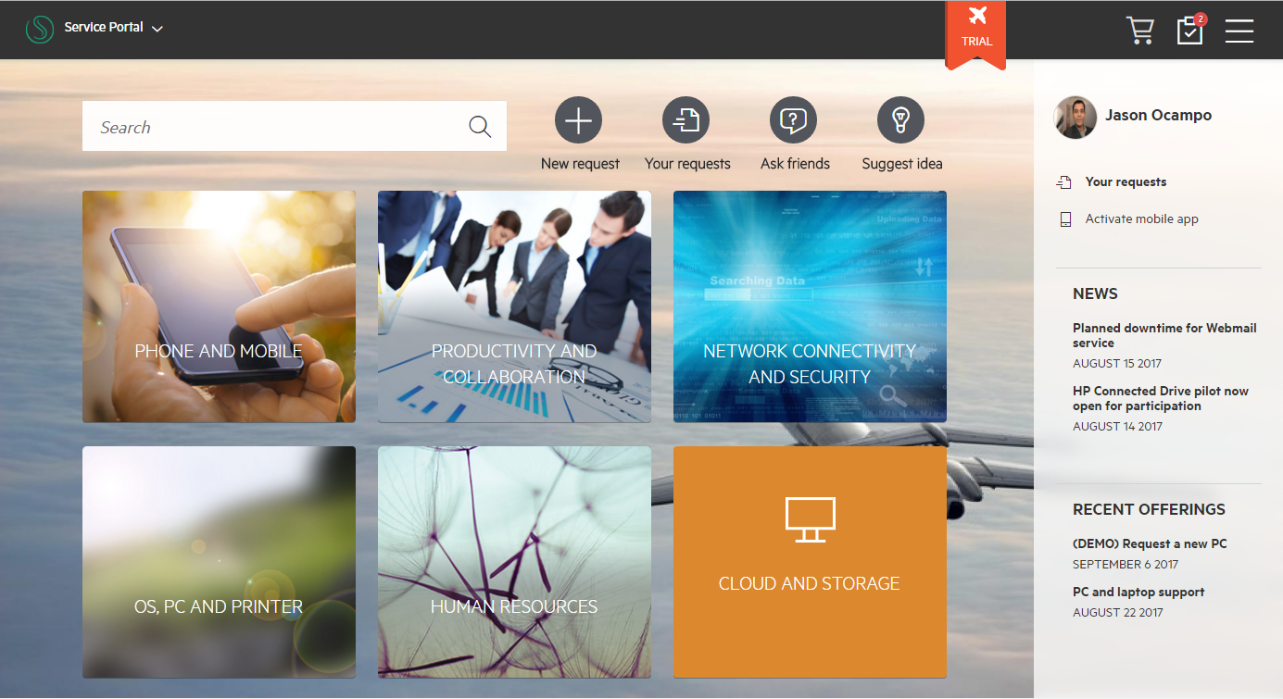
Easy to Use Self-service
Service user experience, any place, any time
Notifications
Shopping cart
IDOL based search
Native mobile app
Personalized
News alerts on active outages.
Catalog offerings
Notes:
One of key capabilities is the service portal including:
- IDOL based search for news, catalog offerings, knowledge articles.
- Integrates service catalog offerings from Service Manager and other tools
- Notifications, providing information like the status of a user’s service request
- Shopping Cart, providing an integrated view of all goods and services offered
- Mobile interface to anytime access from everywhere

Slide 17
Module Breadth
Plan
Build
Run
Service Portfolio
Service Catalog
Time Periods
Service Level Mgmt
Contract and Vendor Mgmt
Idea & Proposal Mgmt
Application Portfolio Mgmt
Project & Portfolio Mgmt
Change
Release
Knowledge
Service Asset & Configuration (SACM)
Survey
Service Request
Incident
Problem
On-Call Schedule
Software Asset
Financials
Notes: SMA-X only
Notes:
Here is SMA-X – all the functionality you’d expect in a service desk, and more. As you look at this slide – the icons across the top show where we consider SMA-X to excel. For example, we are the only saas ITSM solution that has true big data – embedded at our core – not bolted on. That means big data is expressed throughout the application - in the workflows where you need it – the ITSM user does not need to jump out to another application or flip between screens to get the data he needs. Its not just “reports and analytics” (although you’ll like those when we s how them) – its about changing the way you do ITSM – getting to 100% of your relevant business data at the speed of business – in the daily routine of every ITSM role.
Another unique feature of SMA-X is our continuous delivery process. Our new architecture supports a continuous delivery model that allows development to quickly add new capabilities. Unlike other solutions on older architectures who may only be able to deliver 1 or maybe 2 releases per year, continuous delivery can deliver high content in short periods of time.

Slide 18
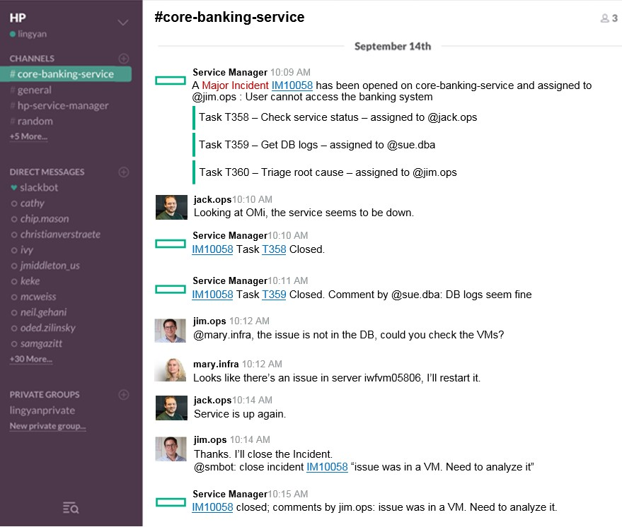
Collaboration
ChatOps
Virtual war rooms
Chat robots are part of the collaboration
Chat flow
Many people can collaborate to solve an issue
Notes: SMA-SM only in 2017.11 release
Notes:
ChatOps is one of the leading innovations in SMA. It provides a virtual war room to efficiently improve IT agent collaboration.
ChatOps helps to solve issues faster in an efficient transparent way using real-time chat
- Assemble the right people, right tools & data at right time
- Cross-boundary collaboration of people, process, tools and automation
- Resolve once, re-use next time … automatically document entire incident resolutions in a transparent, repeatable fashion

Slide 19
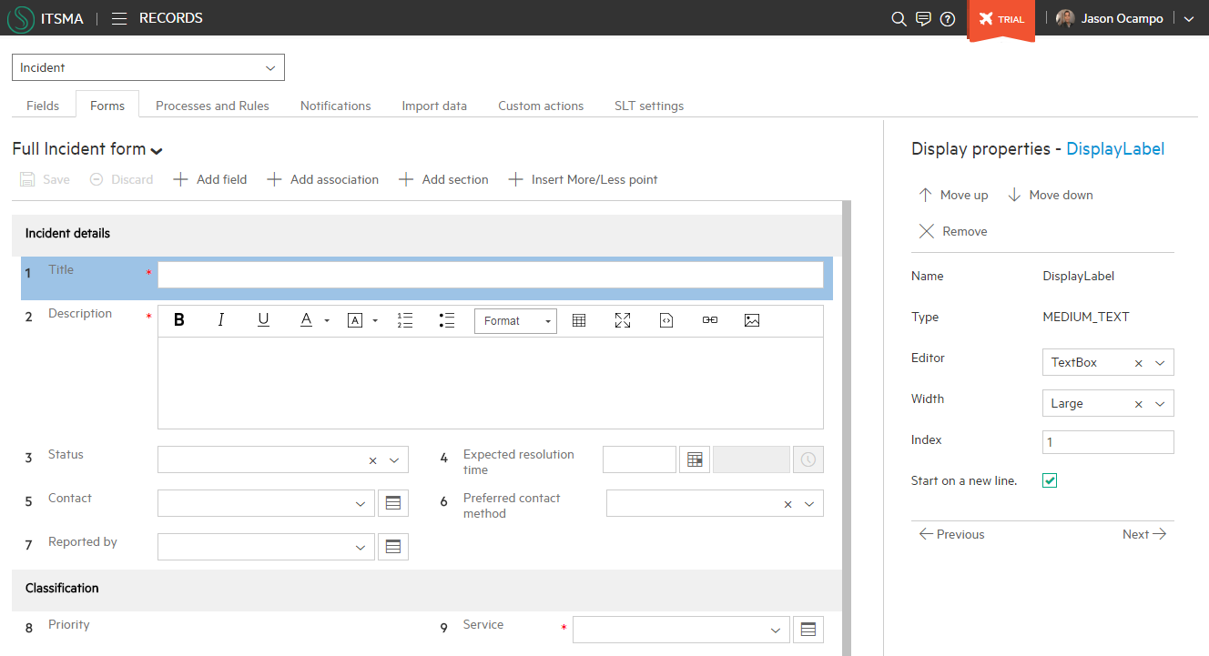
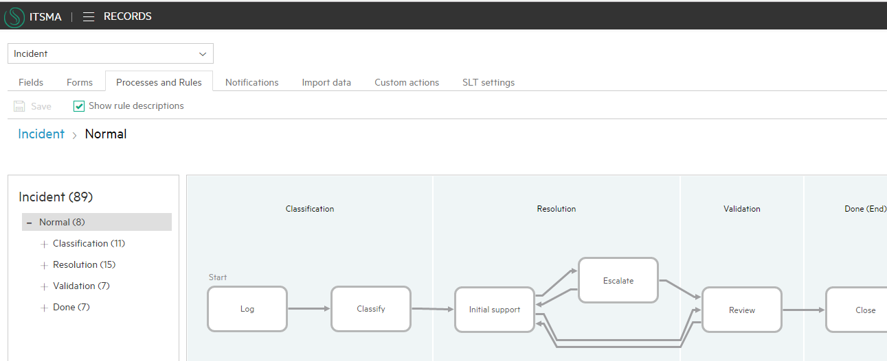
Codeless Configuration
Graphical forms editing
No programming knowledge required
Retains custom configurations for seamless upgrades
Simple graphical interface
Notes:
Process Designer provides simple and efficient customization with codeless configuration. It comes with instant processes and workflows based on ITIL® best practices, which are easy to customize, to configure and to upgrade.
The results: Quick time to value, low total cost of ownership (TCO), and low upgrade and migration costs.
Key characteristics and capabilities of Process Designer include:
Out-of-the-box processes, 100 percent ITIL aligned
Separates system code from user configuration
Single, intuitive and easy to use graphical user interface
Easy to define and maintain workflow and business logic
Based on ITIL and Service Management Reference Model
Support all key processes, including incident and problem management, knowledge management, change management, request fulfillment, and service level management

Slide 20
Flexible Deployment
Fast time to upgrade and reduced TTV
Container Deployment Foundation
REST APIs, Bots
Microservices
Pre-integrated containers, unified license model, and shared services
Cloud & App Release
Orchestration
Capacity
Compliance
IT Broker
Common Services
Easy to install, maintain and patch with zero downtime upgrades
Container Orchestration | Linux | Container Platform
Auto-scaling, HA/DR, self-healing and secure
Managed Container Environment
Flexible Deployment Options
Physical
Virtual
Cloud
Container
Notes:
Container Deployment Foundation – modular, flexible, scalable
The Container Deployment Foundation enables continuous operations for Modern IT. And there are 4 areas that it touches on:
One is in distribution. all of the suites come now with a standard license model. Instead of multiple license model we boiled down to one easily manageable license unit. They come up and are all delivered in pre-integrated containers. OOTB, inside the factory we are doing a lot of pre-integration for standard use cases.
Install and upgrade. Suites built with the Container Deployment Foundation are very easy to install. very easy to maintain, with automated updates, and automated patching. And very soon, over the next couple of quarters we will get to the point when we actually expend the capabilities to have a zero downtime, asynchronous updates.
A key capability in Suites built with the Container Deployment Foundation is auto-scaling. Suite deployments can flex in and flex out, so patches, rollbacks, getting bigger, getting smaller, - it will all just happen. And it happens at scale. It will happen within seconds, to expand the footprint of the product, reduce the footprint of the product, very quickly and very easily.
Deploy Anywhere: It is available to be deployed on-premise, in public cloud, in private cloud. So eventually you will be able to have on-prem, off-prem, in AWS or Azzure. MSPs will be able to offer it, it makes it extraordinarily portable.
All of this done on top of an automated and modern orchestration layer built natively to handle container clusters at scale. The Container Deployment Foundation delivers a state-of-the-art container management and orchestration framework leveraging the Docker container architecture and Kubernetes for orchestration. Both CLI and API management is offered as well.
As the Suites built with the Container Deployment Foundation mature, customers will see Integration and Installation times in just a few hours, Upgrades in a few minutes, Scaling in seconds and HA/DR built-in.

Slide 21
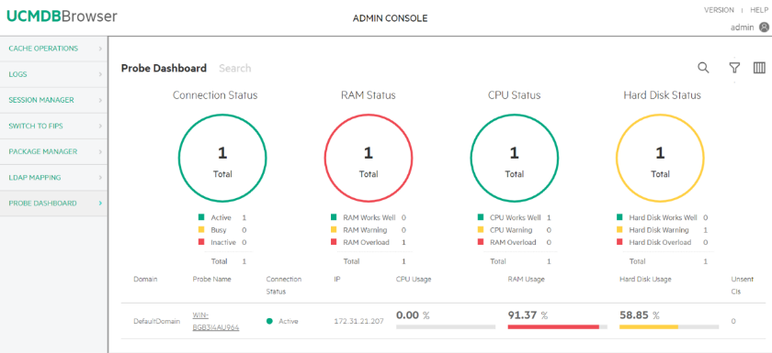
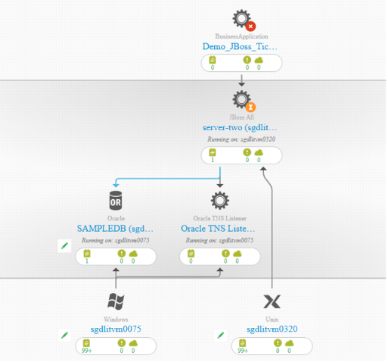
Configuration Management System (CMS)
Industry’s best combination of bottom up and top down discovery and modeling
Intuitive web browser interface Easy access to all CMS data
Single tool Federated CMDB, discovery, inventory and dependency mapping
Automated Discovery Cloud and on premise Top-down and bottoms-up Agent-based, agent-less, hybrid, and passive
Automated service modeling Easy, fast dependency modeling to a top-down model of a business service
Notes:
The Configuration Management System (CMS) is a comprehensive set of tools for collecting, storing, managing, updating and presenting data about IT services configuration items (software and infrastructure) and about their relationships.
CMS includes Automated Discovery (Micro Focus Universal Discovery) and a federated configuration management database (Micro Focus Universal CMDB) that integrates with trusted sources in a seamless fashion-allowing IT management teams to make effective decisions and control changes.
Key capabilities include:
- Agile top-down and bottoms-up discovery - agent-based, agent-less, hybrid, and passive
- Automated service modeling for easy, fast dependency modeling to a top-down model of a business service
- Cloud and on premise discovery capabilities
- Both inventory and dependency mapping in a single tool
- Easy access to all CMS data via intuitive web browser interface
- Common platform integration across all ITSM and Operations Analytics tools

Slide 22
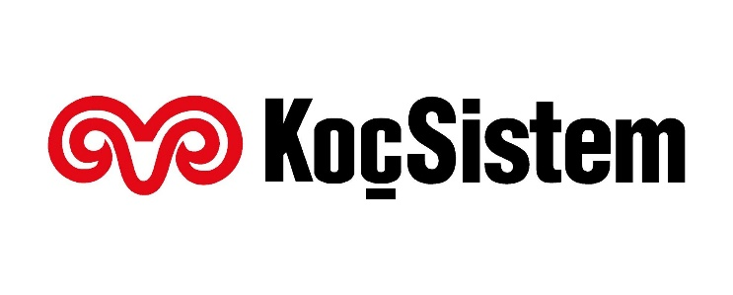


Delivering Customer Outcomes
Ticket self-management delivers a 26% reduction in incidents
Better allocation of help desk resources
$500,000 savings in asset consolidation
50% first year ROI recovery
Increased change success rate to 99%
Achieved 85% first call resolution
Notes:
Sources:
- https://www.hpe.com/h20195/V2/getpdf.aspx/4AA6-2674EEW.pdf (KocSistem)
- https://www.hpe.com/h20195/V2/getpdf.aspx/4AA6-5403ENW.pdf (BCCSS)
- https://www.hpe.com/h20195/V2/getpdf.aspx/4AA5-8967ENW.pdf (Valero)

Slide 23
SMA Suite Licensing

Slide 24

One Suite, One Experience, Two Flavors of Choice
Converging SM capabilities from Service Manager and former Service Anywhere
Service Portal
SMA Suite
One suite for Service Management
Single service portal (SMA SP) and mobile app
Choice of technology flavor at deployment time enabled by ITOM CDF:
SMA-SM for existing SM customers evolving to containers
SMA-X for existing SAW customers or new customers
Flexible options for increased adoption
SMA Service Portal in containers, SM outside containers (Mixed mode)
SMA Service Portal in parallel with SRC or ESS for incremental roll-out
UCMDB inside or outside containers
SMA-SM
SMA-X
1
2
Configuration Management System
1
2
Container Deployment Foundation (CDF)
SMA Suite
Containers only
Notes:
… allowing us to converge and deliver 1 suite, 2 flavors
ITSMA suite a single suite, with single portal and mobile app
X” refers to next generation such as the unified Service Portal delivered in 2017.07 or the end-to-end suite to be delivered in 2017.11

Slide 25
SMA Suite licensing
SMA-SM Express
5 user pack:
Service Management with Smart Analytics
Universal CMDB
Asset Tracking
SMA-SM Premium
5 user pack:
SMA-SM Express
Asset Management (1 user per pack):
Contract
Financial
Software Installation and License Tracking
Software License Compliance
Catalog aggregation
Service Portal
Big Data & Analytics
Service Desk
Change Management
Request Fulfillment
Release Management
Asset Management
Task Automation
Configuration Management System
CMDB and Discovery
SMA-X Express
5 user pack:
Service Management with Smart Analytics
Universal CMDB
Asset Tracking
SMA-X Premium
5 user pack:
SMA-X Express
Asset Management:
Contract
Financial
Software Installation and License Tracking
Idea & Proposal
Application Portfolio
Project & Program
Optional SMA 50 Node packs:
Universal Discovery
Operations Orchestration

Slide 26
Language support
Localization support added in 2018.02 for Service Portal and SMA-X agent UI
Capabilities/ Modules | Supported languages
 | English | Arabic | Brazilian Portuguese | Danish | Dutch | French | German | Greek | Italian | Japanese | Korean | Norwegian | Polish | Turkish | Russian | Simplified Chinese | Spanish
CDF Management Portal | Y |  |  |  |  | Y | Y |  |  |  |  |  |  |  |  |  | Y
Service Management | Y | Y | Y | Y | Y | Y | Y | Y | Y | Y | Y | Y | Y | Y | Y | Y | Y
CMDB | Y |  | Y |  |  | Y | Y |  | Y | Y | Y |  |  |  | Y | Y | Y
Suite Administration | Y |  |  |  |  | Y | Y |  |  |  |  |  |  |  |  |  | Y
My Home | Y |  |  |  |  | Y | Y |  |  |  |  |  |  |  |  |  | Y
Service Portal | Y | Y | Y | Y | Y | Y | Y | Y | Y | Y | Y | Y | Y | Y | Y | Y | Y

Slide 27
SMA Architecture and Deployment Options

Slide 28
Mixed Mode – Flexible options for existing SM customers
Supported scenarios
For customers who want to experience new service portal
SM and UCMDB outside
UCMDB outside, SM inside CDF
For customers who want to experience suite in phases
SM Web
SMA SP
UCMDB
SM Web
SM RTE
IDOL
UCMDB DB
SM RTE
OpenFire
UCMDB
SM DB
SMA SP
IDM
UCMDB
IDOL
UCMDB DB
OpenFire
IDM
SM 9.41+ (no chat nor survey)
SM 9.5x (full SMA-SP)
UCMDB to SM integration following current matrix. Refer CP support matrix
Classic components
Containerized components

Slide 29
Functional Architecture of SMA-SM (Full Container)
SMA-SM 2018.02
Service Manager
Service Portal
SmartA
CMDB
Suite Admin
Collaboration
Capability
SM Mobile
Landing page
SX
Catalog
Portal UI
Survey
Search
Others …
IDOL farm
Smart Ticketing
Smart Search
OCR
UCMDB
UCMDB Browser
UD Integ’
Deployer
Configuration UI
Chat
Component
Incident
Change
Problem
Request
SLA
Configuration
Others…
ITOM Core Platform
Security
Infra
Data Store
Secret Mgt _{(Vault)}
IDM
AutoPass
Gateway_{(Nginx)}
Config Map _{(ETCD)}
RDB _{(PostgreSQL)}
Redis
Oracle

Slide 30

Functional Architecture of SMA-SM (Mixed Mode 1)
SMA-SM 2018.02
UCMDB and SM outside container
Classic Environment
SMA-SM Suite Services
Service Manager
Mobile
Chat
Service Portal
Landing Page
Suite Config UI
Smart analytics
UCMDB
UCMDB
Service Manager
Infra Services
RDB Service _{(PostgreSQL)}
Reverse Proxy
Load Balancer
IDM
Logging
Config service
Secret service
AutoPass
Management Portal
Monitoring
Customer Infra
Linux Server
Storage _{NFS}
RDB _{Oracle}
Network
Linux Server
Linux Server
Linux Server

Slide 31
Functional Architecture of SMA-SM (Mixed mode 2)
SMA-SM 2018.02
UCMDB outside container
Classic Environment
SMA-SM Suite Services
Service Manager
Mobile
Chat
Service Portal
Landing Page
Suite Config UI
Smart analytics
UCMDB
UCMDB
Infra Services
RDB Service _{(PostgreSQL)}
Reverse Proxy
Load Balancer
IDM
Logging
Config service
Secret service
AutoPass
Management Portal
Monitoring
Customer Infra
Linux Server
Storage _{NFS}
RDB _{Oracle}
Network
Linux Server
Linux Server
Linux Server

Slide 32
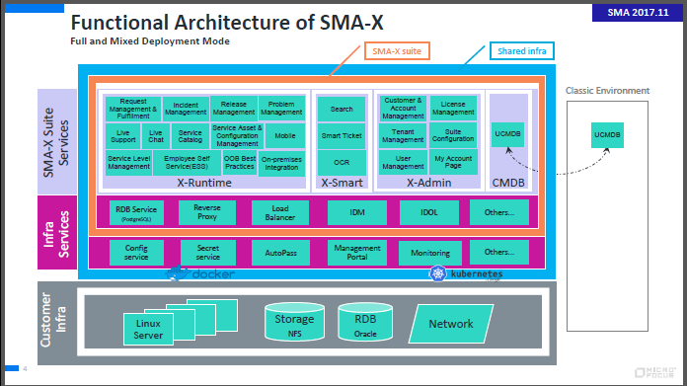

Slide 33
SMA-X Architecture
Master node
(controller)
Worker node
(suites)
ITOM Core
SMA-X Suite
Heapster
SMA-X Runtime
Suite Admin
IDM
Management portal
IDM
IDM Postgres
SMA-X Persistence Infra
Suite Admin Postgres
IDM
Postgres
System
Kubernetes-vault
Suite installer
Suite installer Postgres
Autopass LM
Smart Analytic
Suite Ingress controller
Flannel
Kubernetes
Autopass LM Postgres
Vault
Kube-DNS
Scheduler
API server
System
ETCD
Kube-proxy
Controller-manager
Kube-registry
Flannel
Kubernetes
Bootstrap Docker
Kube registry-proxy
Nginx Ingress controller
k8s-dns-dnsmasq / sidecar
Bootstrap Docker
Kube registry-proxy
Kube-proxy
Kubelet
Kubelet
Platform Docker
Platform Docker
Host OS
Storage
Host OS
Storage
System
Kubernetes
CDF / shared
Suite

Slide 34
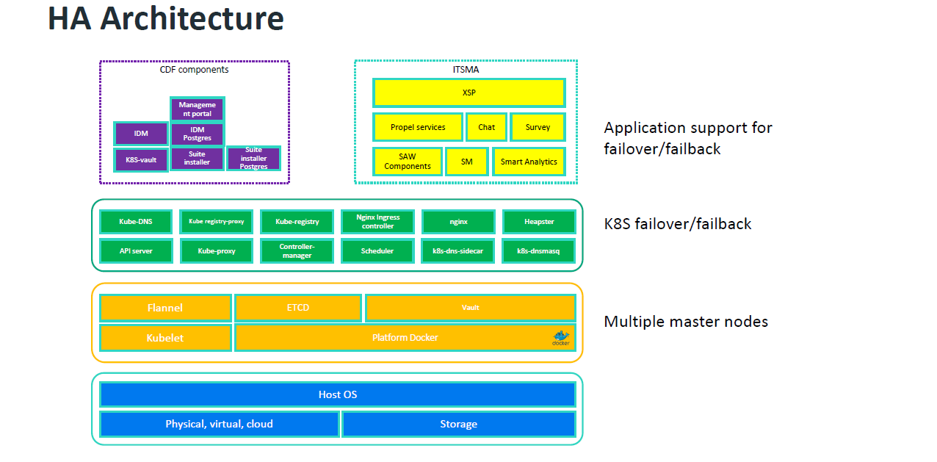
HA Architecture

Slide 35
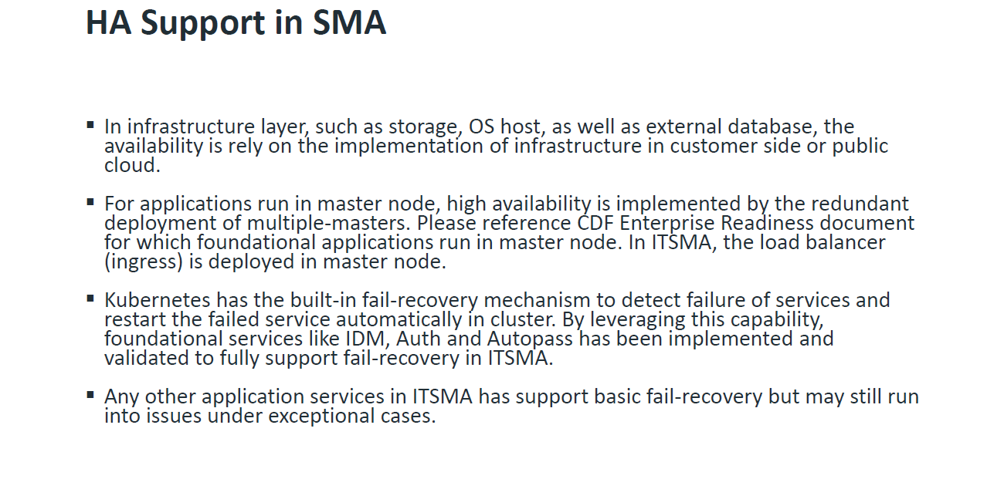
HA Support in SMA

Slide 36

SMA on AWS
SMA 2018.02
Elastic IP
Route 53
DNS
Security Group
VPC
EFS
K8S cluster
Provisioned by scripts
SMA provides the automation scripts
Ingress
Auto Scaling Group
Ingress
Worker
Master
Worker
Ingress
Master
Worker
Master
<<External DB>>
Set by customer
SMA provides document for manual setup
NFS on EC2
RDS
EC2
New features in 2017.11
SMA provides new features in automation scripts
EBS
Oracle
PSQL
Infra provision automation
AWS VPC (VPN)
On Prem
LDAP
For integrations only
Other Apps

Slide 37
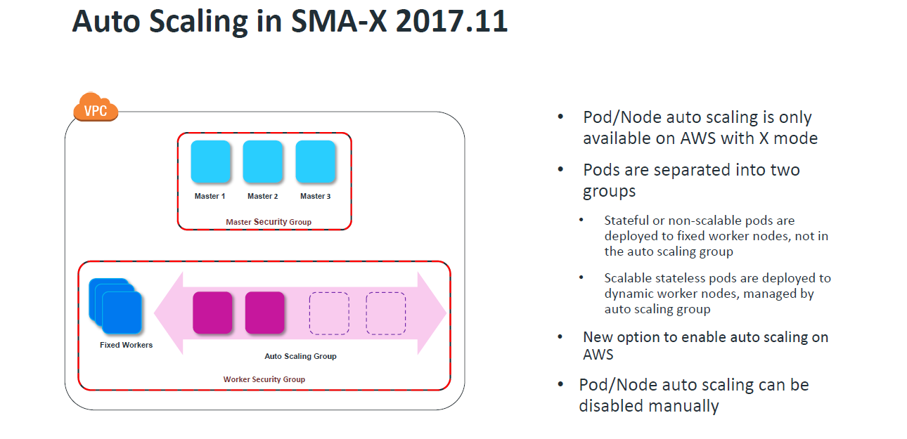
Auto Scaling in SMA-X 2017.11
Currently supported pods
•itom-xservices-serviceportal
•itom-xservices-platform-online
•itom-xservices-gateway

Slide 38
Multi-tenant Deployment Options for SMA-X

Slide 39
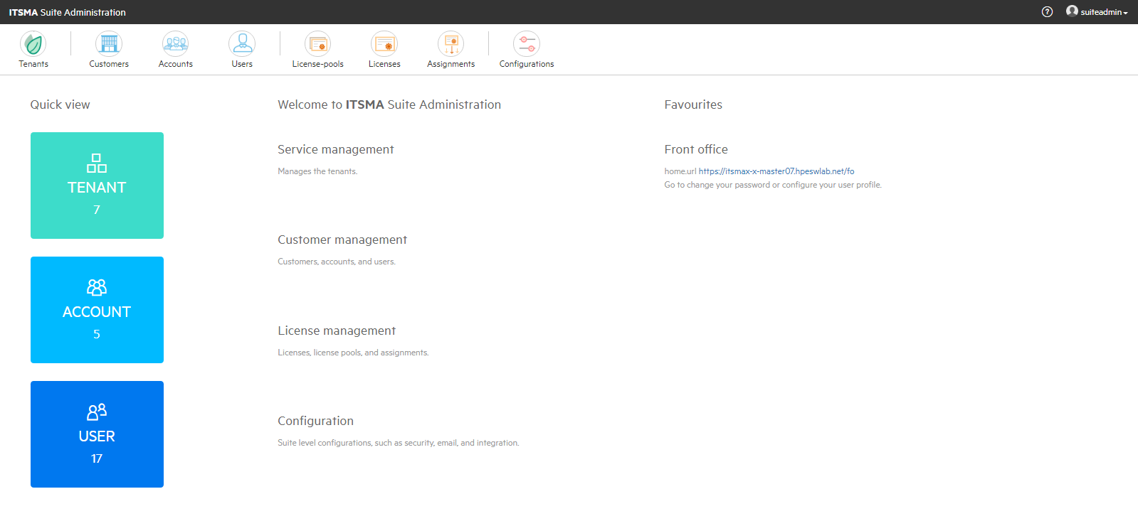
SMA-X Suite Administration Portal
Brand new Admin Portal for SMA-X
Manage an SMA-X Instance, which may have multiple:
Customers
Accounts
Tenants
Licenses / License Pools
Access via https://<yourserver>/bo

Slide 40
Multi-Domain: Multiple Domains in one Tenant
Domains share a common configuration – rules can use conditions where appropriate
Leveraged agents can access multiple domain seamlessly
Not all aspects are covered by domain segmentation (e.g. SACM data, configuration)
Group Based Entitlement
Core Namespace (CDF)
SMA-X
IDM
Tenant A
Service Portal
Domain Segmentation
SMA-X Backend
Domain A
Domain B
Domain C
Multiple Tenancy
UCMDB
K8S Deployment (Farm)
Notes:
Domains share a common configuration – rules can use conditions where appropriate
Leveraged agents can access multiple domain seamlessly
Not all aspects are covered by domain segmentation (e.g. SACM data, configuration)

Slide 41
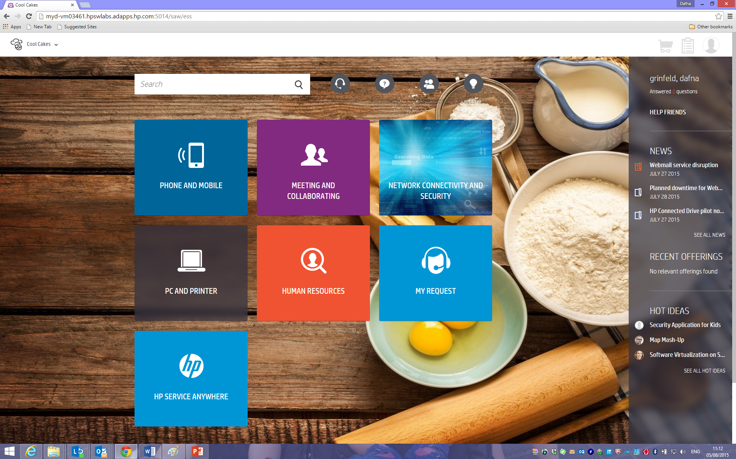
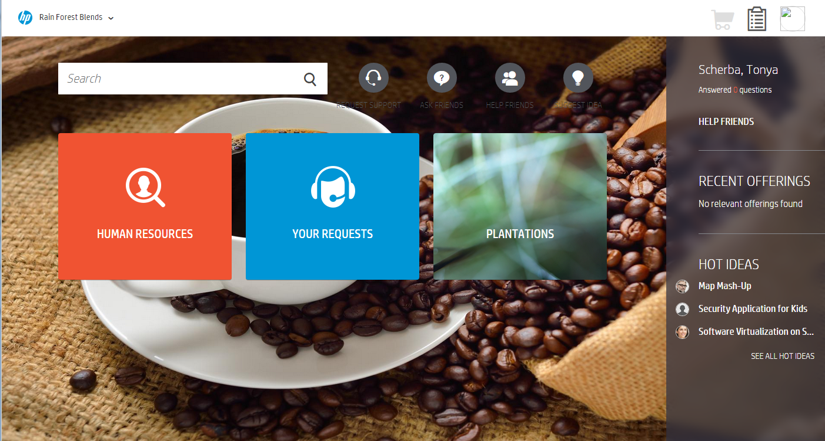




Multi-Domain: Use Case Example
Client A
2
Client B
Considerations:
What is in common for the clients – processes, workflow, forms etc.
Who will operate – shared agents, dedicated agents, client have his own agents
The following entities are currently segmented:
Incident, Request, Problem, Change, associated SLT, Tasks, Article, Hot Topic and reports
Surveys and Chats
Future: SACM (CIs, service etc), Idea, Proposal, Contract, Vendor, Project, Program
3
I need to request medical leave.
I need laptops for my team.
I need to request a new laptop.
Entitlement rules
1
Domain segmentation
1
Domain segmentation
HR Agent
IT Support Agent
2
White labeling
3
Catalog Category entitlement

Slide 42
Multi-Tenant: Multiple Tenants in one Instance
Tenants receive updates at the same time
Each tenant has independent configuration
Leveraged agents need to login to each system independently
Core Namespace (CDF)
SMA-X
IDM
Tenant A
Tenant B
Service Portal
Service Portal
SMA-X Backend
SMA-X Backend
UCMDB
K8S Deployment (Farm)
Notes:
Tenants receive updates at the same time
Each tenant has independent configuration
Leveraged agents need to login to each system independently
Future: Multi-tenant console will provide access to several tenants for a leveraged agent

Slide 43
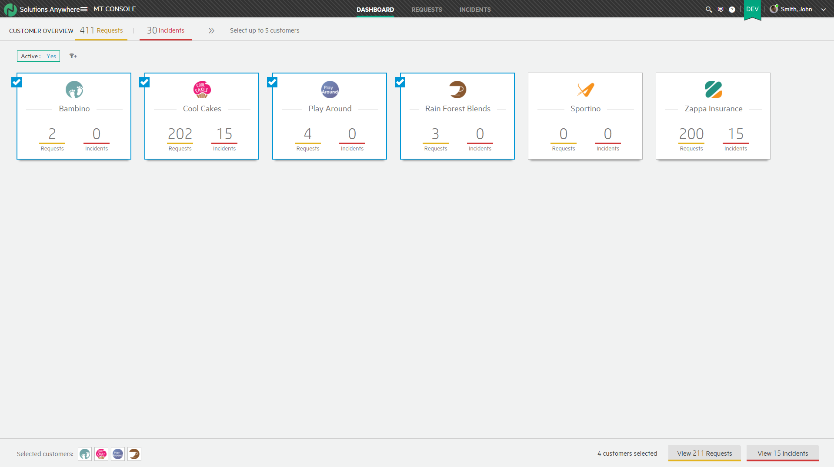
Multi-Tenant Console
Lines of Business, MSPs and shared services can decide to manage their clients separately.
In such a deployment all existing functionality exists for each one of the clients separately.
In addition, the multi-tenant console** gives an agent who is working on multiple clients a simple and intuitive dashboard and grid which contains all the information of the clients in one place and allows him to drill down without the need to login to each tenant separately.
**NOTE: MT Console available in a future release

Slide 44
Mixed Multi-Domain and Multi-Tenant
For some deployments a mixed approach will be the right one to choose.
In this approach the customer can enjoy the best of both worlds by matching the right solution to each client while considering costs
Tenant
Agents
Domain
Shared Service Tenant
Client A
Client B
Client C
Shared Clients
Client D
Client E
Client F

Slide 45
Multi-Instance (greatest degree of separation)
Each instance can be updated independently
Each instance has separate configuration
Leveraged agents need to login to each system independently
Instance A
Instance B
Core Namespace (CDF)
SMA-X
Core Namespace (CDF)
SMA-X
IDM
Tenant A
IDM
Tenant A
Service Portal
Service Portal
SMA-X Backend
SMA-X Backend
UCMDB
UCMDB
K8S Deployment (Farm)
K8S Deployment (Farm)
Notes:
Greatest degree of separation
Each instance can be updated independently
Each instance has separate configuration
Leveraged agents need to login to each system independently
Can we combined with other options of course

Slide 46
Multi-tenant Deployment Options: Comparison Summary
 | Multi-Domain | Multi-Tenant | Multi-Instance
Features | Manage multiple organizations in a single Tenant Share single codeless configuration Share single Catalog/KM content across clients | Manage multiple clients in dedicated tenants Each tenant has its own custom configuration Multi-tenant console* provides single inbox across clients | Manage multiple clients in separate Instances Each instance can have its own independent upgrade cycle Each instance can be hosted in optimized infra for its expected load
Limitations | Segmentation limited to Service Management data No segmentation of SACM/AM/Project data | In roadmap: easy sharing of common KM/Catalog | Additional infra and operation costs Each instance fully independent, with no consolidated inbox for all clients
Best Practice Use | Operate several Lines of Business in a single Tenant, with data separation Manage multiple small clients in single Tenant, with low cost overhead | Great for MSPs, with ability to manage their customers independently, offering each dedicated configurations | For MSPs, instances may be deployed in different regions for geo-distributed customer base Especially large customer may have its own dedicated instance tuned for its lifecycle and scale needs NOTE: Separate instances may also be used for separation of Dev and Prod environments, for the benefit of having independent upgrade/test cycles

Slide 47
SMA-X versus SMA-SM Feature Comparison

Slide 48
Module Differences
 | SMA-X | SMA-SM
Financial¹ | Net Value simulation Budget Lines | Asset Manager: Budget & Expense lines
Software License tracking¹ | ✔ | Asset Manager
Software License Compliance¹ |  | Asset Manager
Idea & Proposal¹ | ✔
Application Portfolio Mgmt¹ | ✔
Project & Program Mgmt¹ | ✔
1 – Requires Premium license

Slide 49
Functional Differences
 | SMA-X | SMA-SM
Pink Verify | 2 processes | 11 processes
Hot Topic Analytics beyond Service Desk, Incident, Problem, Survey records | User searches User questions
Change Analytics | ✔
Reporting | Built-in reporting BI API | Built-in reporting Any SQL reporting tool
CI auto-detection in description field | ✔
Auto-scaling on AWS | ✔
ChatOps | On roadmap | ✔
Provide relevant related information while in a record | News and KM docs Suggested Solutions Related Contracts Success of similar changes | News and KM docs Suggested Solutions Similar changes with RC

Slide 50
Administration differences
 | SMA-X | SMA-SM
Migrate configuration and data from one instance to another | Full with Dev2Prod utility but excludes offering options, Clone tenant Export/Import tenant | Unload files Delta Migration tool
Multi-tenant | Data segregation for some processes Multi-tenant architecture MT Console (future release) | Field-level access controls Data Policies Mandanten
Organization/department hierarchy |  | ✔

Slide 51
Configurability differences
 | SMA-X | SMA-SM
Configure a new form | Add conditions to OOB forms (New, Full, Preview) | ✔ using Windows client
Configure a new workflow | Add conditions to OOB workflow Configure new Workflow(on roadmap) | ✔
Number of custom fields | Limited (user options unlimited) | Unlimited
Custom Searchable fields | 2 per record type | Unlimited
Text field size and quantity | Fixed number of each size (Short, medium, long) | Unlimited number and custom size
Linked fields | Person or Group only | ✔
Non-volatile lists | Limited (20 lists of 25 items) | Unlimited
Workflow scripting or custom action | Business rules with URL, OO flow, REST API | Process Designer, Javascript or docEngine
Configure a new application | (on roadmap) | ✔
Localization | Service Catalog KM articles | Service Catalog KM articles UI localization toolkit
Branding | Portal Logo can be changed in agent UI | Portal Agent UI

Slide 52
Integration differences
 | SMA-X | SMA-SM
UCMDB | Replication | Replication Federation Consolidated impact analysis for change records
Automation (OO) | Any task | KM Article Request Tasks Change Change Tasks
OpsB (OMi) | Unidirection (OMi -> SMA-X) | Bidirectional Change Outage template
Web Services | REST | SOAP, REST
Integration Tools | On-premise bridge | Integration Manager

Slide 53
SMA-Service Portal differences
 | SMA-X | SMA-SM
User Actions |  | ✔
Approval delegation management | ✔
Social Q&A | ✔
Public Request & “Me too” following | ✔
Translation with Google Service | ✔
Ideas¹ | ✔
Subscriptions | View | Manage
CSA aggregation¹ |  | ✔
1 – Requires Premium license

Slide 54
Service Catalog Differences
 | SMA-X | SMA-SM
User option dependencies | List options only | All option types
Category hierarchy | 3 levels | 3 levels OOB. Unlimited, but only 4 levels in SMA service portal

Slide 55
Agent Interface Differences
 | SMA-X | SMA-SM
Mobile interface for agents | Tablets supported for browser UI | ✔
Record IDs | No prefix but color-coded by record type Numbers assigned across all modules | Prefix configurable Numbers assigned within module
Sort and Filter | Limited number of direct sort fields | Sort and Filter on any field
Export a view list | Export to Excel or csv only Export of description (multi-array) field not supported | Multiple formats supported
Export a record | Send by Email | ✔
User Q&A collaboration (including Moderation) | ✔

Slide 56
Knowledge Management Differences
 | SMA-X | SMA-SM
Document Views to maintain one article for multiple audiences |  | ✔

Slide 57
Service Desk Differences
 | SMA-X | SMA-SM
Category hierarchy | 3 levels | 3 levels OOB but more levels can be configured
Create Smart Interaction in Agent UI using an image to be scanned | Drag and drop image on description field

Slide 58
Incident Management Differences
 | SMA-X | SMA-SM
Incident Models | ✔
Incident Tasks | In model or manually add | Manually add
Impacted Services |  | ✔

Slide 59
Problem Management Differences
 | SMA-X | SMA-SM
Known Errors | Checkbox on problem record | Separate KE and PM records but both in rootcause table

Slide 60
Change Management Differences
 | SMA-X | SMA-SM
Collision Detection | Based on date and CI Blocks change from advancing | Based on date, CI, or related CI hierarchy, implementer, location using RC Can choose to override collision
Automated task creation for all Affected Cis |  | ✔
Impact Analysis | One CI at a time | Consolidated impact analysis with UCMDB
Calendar | Changes only Next available window Drag and drop to reschedule Updates change dates in calendar view Avatar and direct link to change owner | Changes and Tasks Next available window using RC Favorites (saved views)
Two-factor authentication for approvals | ✔
Change Analytics | ✔

Slide 61
Release Management Differences
 | SMA-X | SMA-SM
Release module and record type | ✔ | Change record with release category and workflow
Release calendar (gantt view of related changes) | ✔

Slide 62
Service Level Management Differences
 | SMA-X | SMA-SM
Module support | Support Request Service Request Incident | Interaction Service Catalog Incident and Tasks Requests and Tasks Problem and Tasks Change and Tasks
Service Level Target types | Process | Process Availability (based on incident outage)
Service Agreement types | SLA, OLA Underpinning Contract implemented as an OLA with an external provider group | SLA, OLA, Underpinning Contracts

Slide 63


Common Questions
Be ready and confident to discuss any of the following:
Product History and Roadmap
Customer Footprint and Breadth
Process and ITSM Depth
SMA-X vs. SAW vs. Propel vs. SM positioning
References
Analysts
Mobility
Containers

